Slide 1
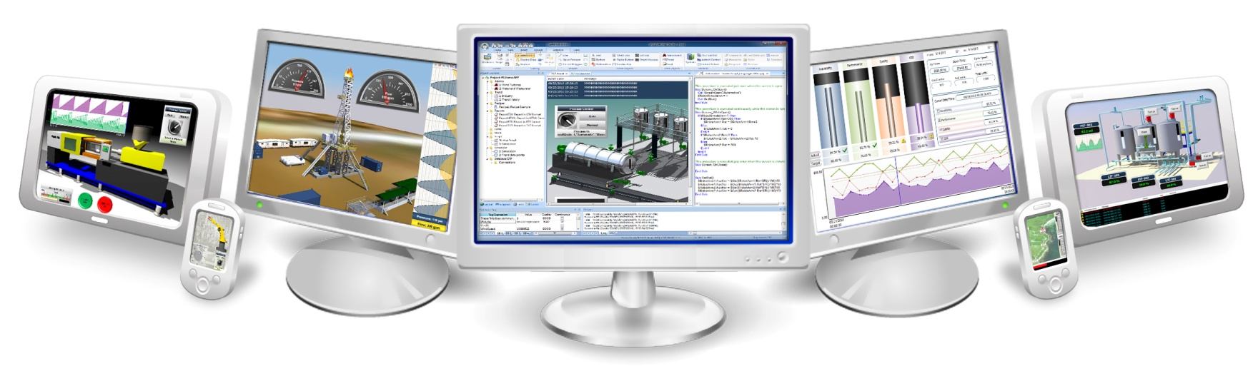
Introduction to InduSoft

Slide 2
Market in Energy

Slide 3
“The assets in a modern industrial facility are not limited to rotating machinery, but to software and service that add value to the system.”
-GE Power

Slide 4
InduSoft Role in Energy
Oil & Gas
Drilling & Production
Exploration & Development
Refining & Petrochemicals
Transportation & Storage
Power Generation
Biofuels & Biomass
Fossil Fuel
Geothermal
Hydro
Nuclear
Solar
Wind
Power Distribution
Utilities Network
Utilities Retail
Mining & Commodities
Carbon
Coal
Minerals & Materials
Nuclear fuels
Energy Management/Green Power
Building Automation
Smart Buildings
Smart Metering
Security

Slide 5
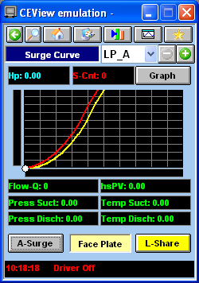
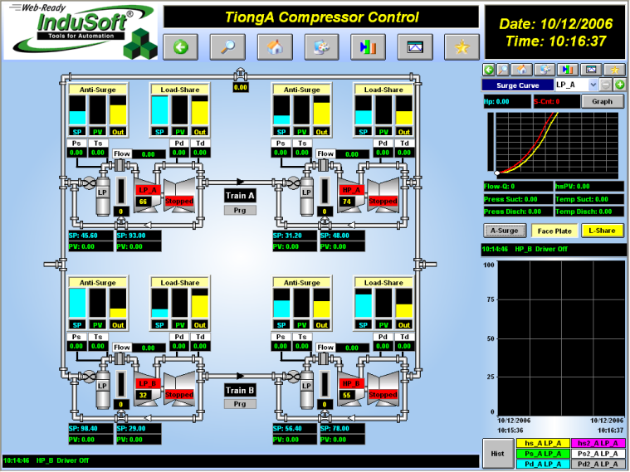
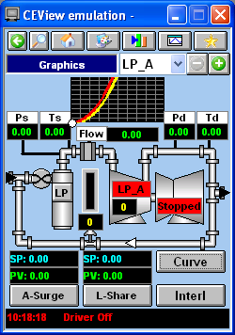
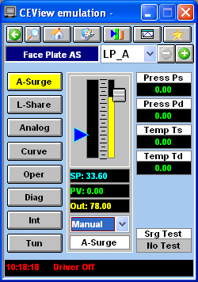
Turbomachinery Controls
Case Study: ICP Triplex, a Rockwell Automation Company
“ We showed the remote condition monitoring
capability to our customers and they loved it!”
Roman Rammler
"We did not have any trouble making the Web Studio software work," recalls Rammler, "and we had excellent support from InduSoft's technical staff."

Slide 6

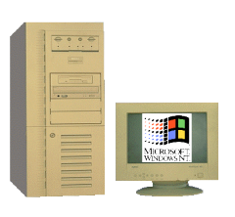
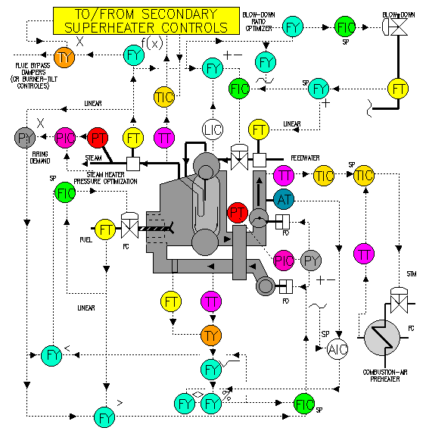

Turbomachinery Controls
Micon OPC Server
(Controller)
CEView OPC Client
(HMI)
OPC
SCADA / Database
(TCP/IP, OPC
ODBC, DDE,
XML, ActiveX)
TCP/IP
Internet
Intranet
WinNT/2k/XP
Compressor
TCP/IP
Web Thin Client
(Internet Explorer,
ActiveX)
TCP/IP
U200
WinCE
Open
Architecture
Windows Vista/NT/XP
Combustion
CEView

Slide 7


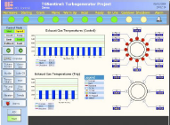
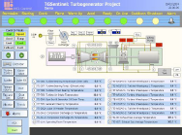
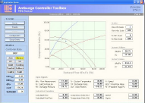
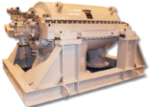
Oil & Gas Monitor and Control
What the system does:
The graphic interface (screens) provide commands (buttons) to trigger actions, such as starting the compressor or shutting it down. All critical commands are protected by user and password and logged for traceability.
Using mobile PDA’s or a computer in the control room, the operators can monitor compressor conditions in real-time.
Charts such as “Surge Curves” provide online status about the current operation of compressors at a glance.

Slide 8
MCL – Oil & Gas Monitor and Control
Benefits:
The operators are aware of alarms and alerts immediately and they can react wherever they are – not necessarily in the control room.
The operators can trigger commands or change calibration settings from the PDA while visualizing the actual equipment. Therefore, they do not have to rely only on the data provided by the control system. They have real feed-back on every action, in real-time.
Stand-alone architecture of the software running on the PDA increases the reliability of the system, because operators can trigger critical commands from PDAs, even if the control room is not available.

Slide 9


Energy – Petrobras Laplace
SQL DB
Intranet
Petrobras Laplace system integrates real-time data from the DCS systems and triggers the execution of production-specific algorithms developed by experts. The results are stored in a central database, which can be used to compare information from different refineries and find ways to improve the efficiency of the process. The openness and flexibility of InduSoft Web Studio made it possible to create a standard project, which supports new calculation algorithms automatically.
Calculation
Algorithms
IWS
DCSs

Slide 10
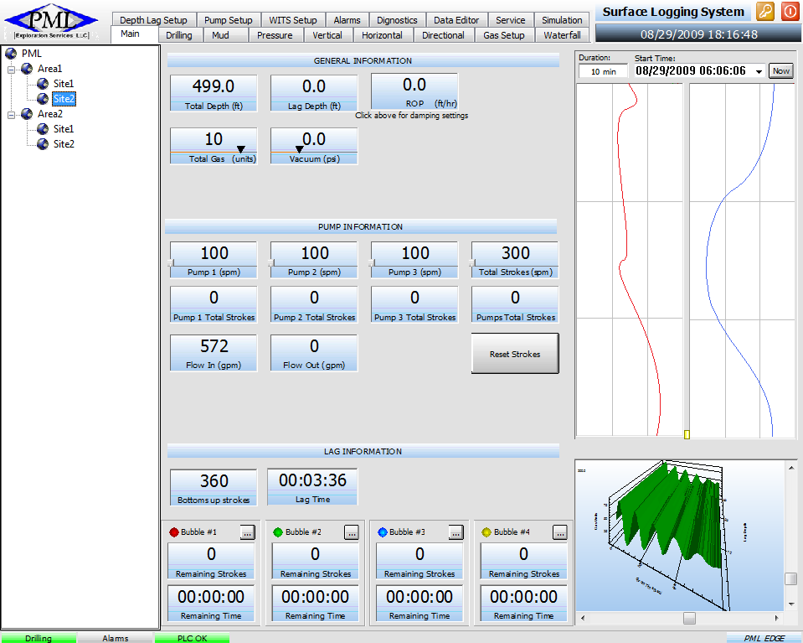
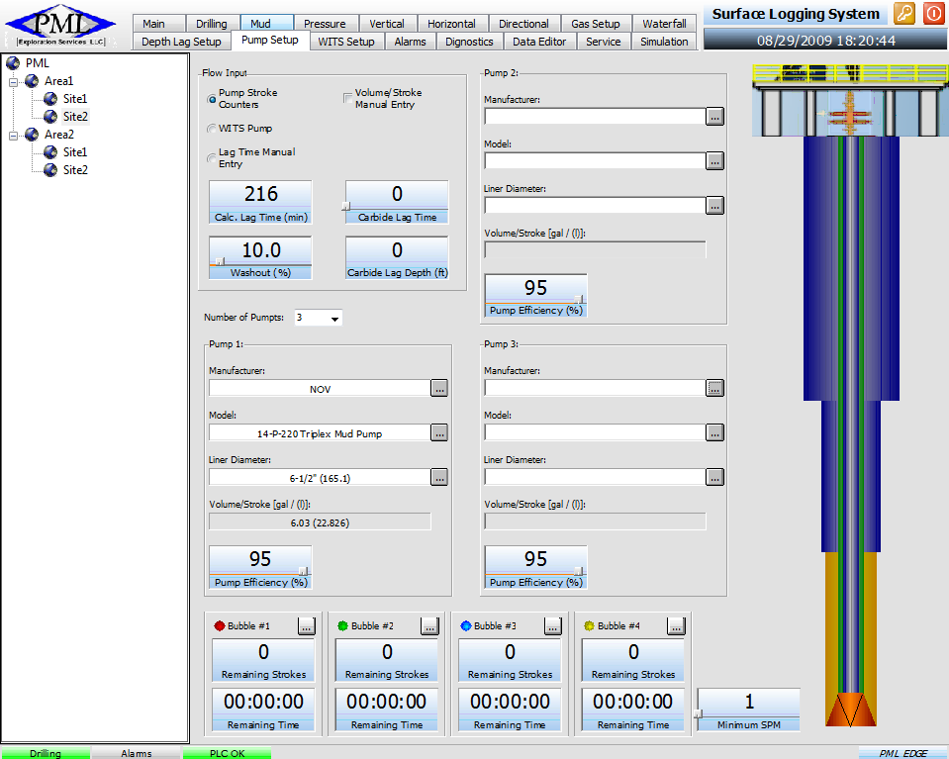
Energy – Gas Exploration
Log the information locally at the site and forward it automatically to a remote server, which provides web access to the online and history information, filtering information based on a pre-configured security system (each customer can visualize data and reports from their own sites only)
Monitor in real-time the drilling process and present relevant information in a meaningful format, used to improve the efficiency of the process and minimize the risks

Slide 11
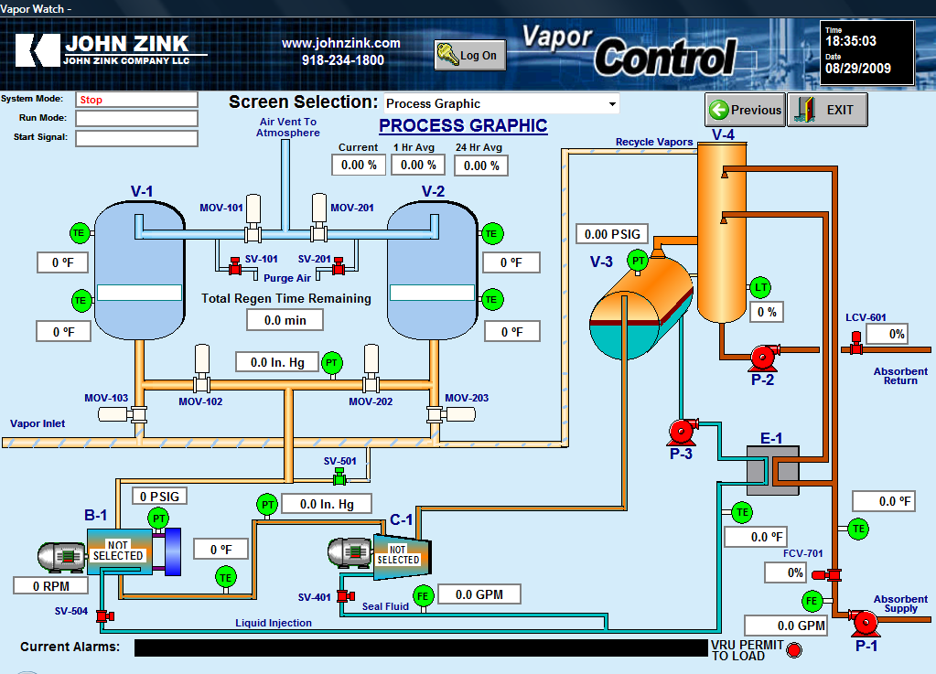
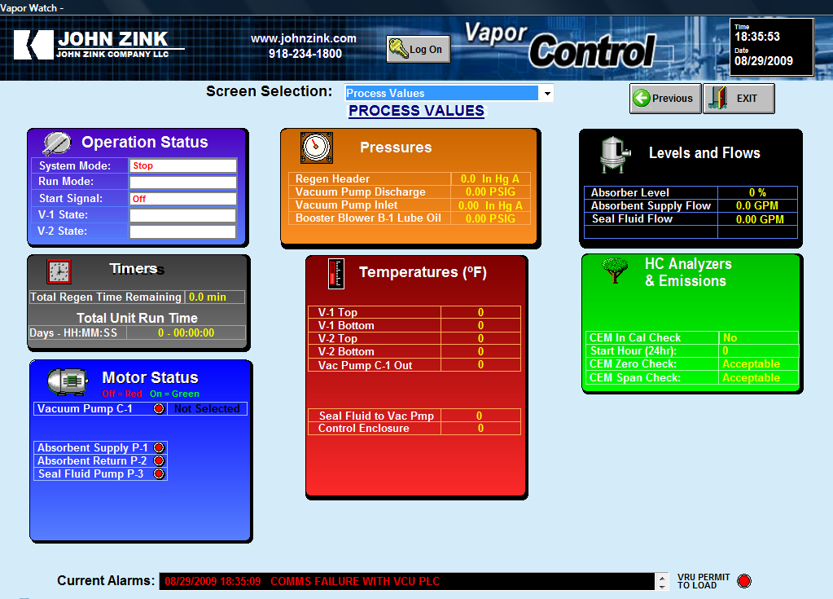
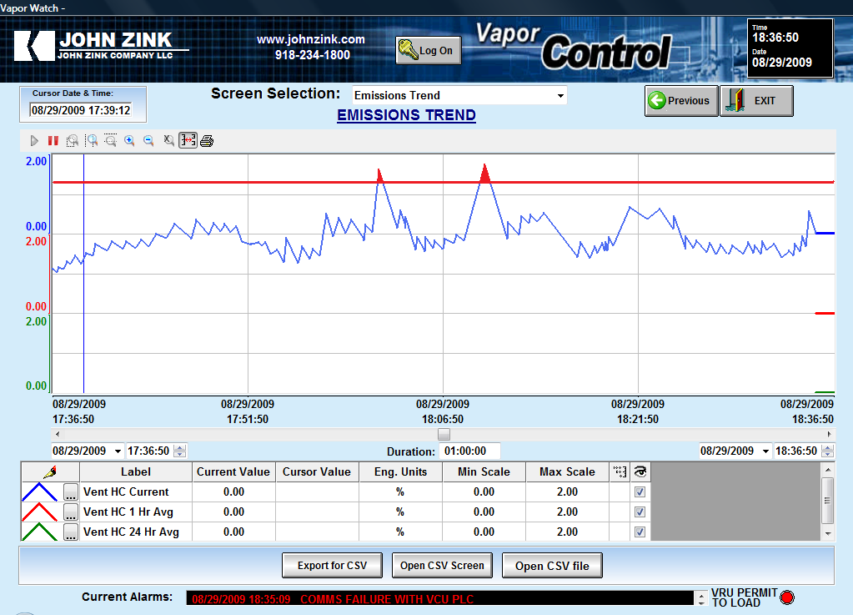
Energy – Compliance with regulations
Web-based SCADA system monitors process and equipment 24-7 and logs critical variables such as levels of emission of gases and generates remote notifications when it forecasts that the levels required by the applicable regulations will not be respected.

Slide 12

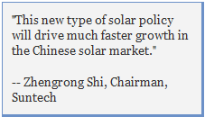
Market Trends – Renewable Energy
Renewable energy into spotlight worldwide
Growing capital investments due to CO2 reduction
targets around the world
Government mandates help push renewables
to dominate by mid-century
Changing policies in China and India is increasing
demand for Solar power. India’s stated goal is to have
10% of the country’s total electricity requirements by 2012
be Solar.
More complex energy mix by 2020 with renewables
increasing in market share
It has been stated that wind energy could generate as much as
20 percent of U.S. electricity demand by 2030 and create as
many as 250,000 jobs if its full potential is pursued on land and
offshore.
Notes:
The Chinese government is readying a feed-in tariff (FIT) for utility-scale solar plants that will dwarf the country's previous solar subsidies, and drive a wave of investment into the sector
Regionally customized
heterogeneous fleets of
fossil, wind, solar, etc.

Slide 13
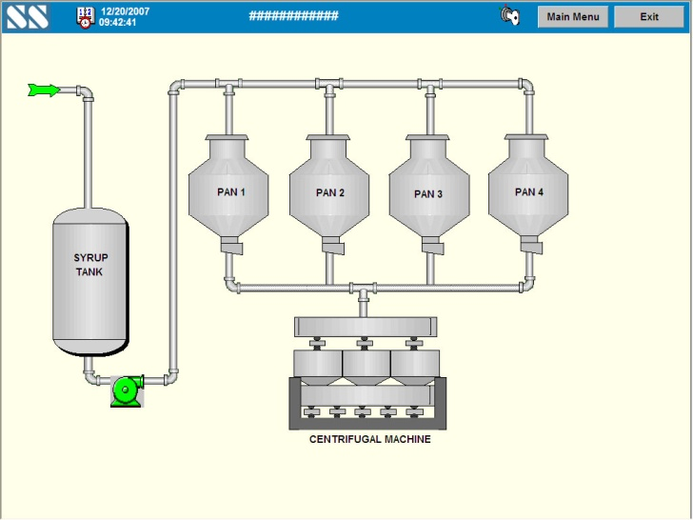
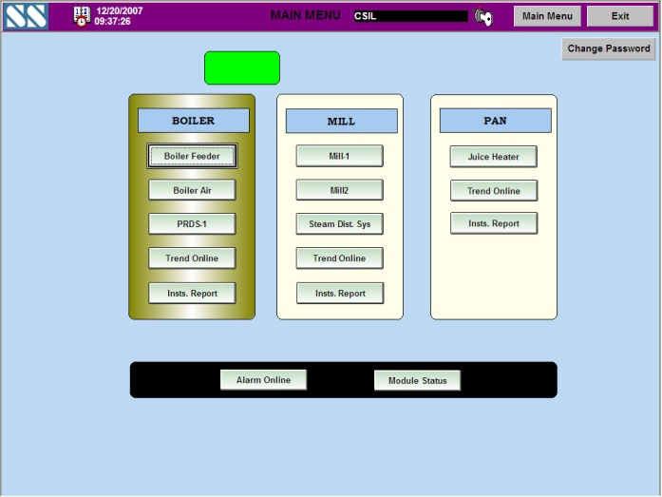
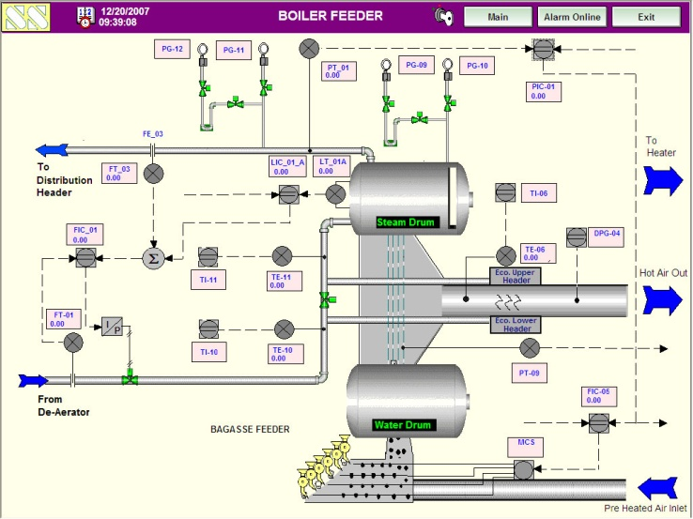
Renewable Energy - Sugar
Case Study: RRB Sugar Mills Ltd. – one of India’s largest sugar producers
Equipment: - Turbo-alternator with two high-pressure boilers, a turbine generator,
and a back-pressure turbine generator
The system has
improved efficiency
reduces the per-unit
generating cost.
Because the system is
less volatile, service calls have
been substantially reduced.

Slide 14
Renewable Energy – Sugar
Case Study: Açúcar Guarani SA - Brazil-based company engaged in the
cultivation of sugar cane and the production and trading of sugar, ethanol and
derivatives of sugar cane.
Benefits:
Increased throughput capacity and alcohol yield

Slide 15
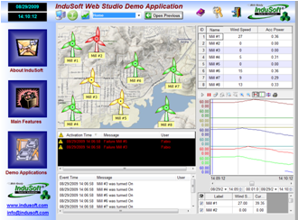
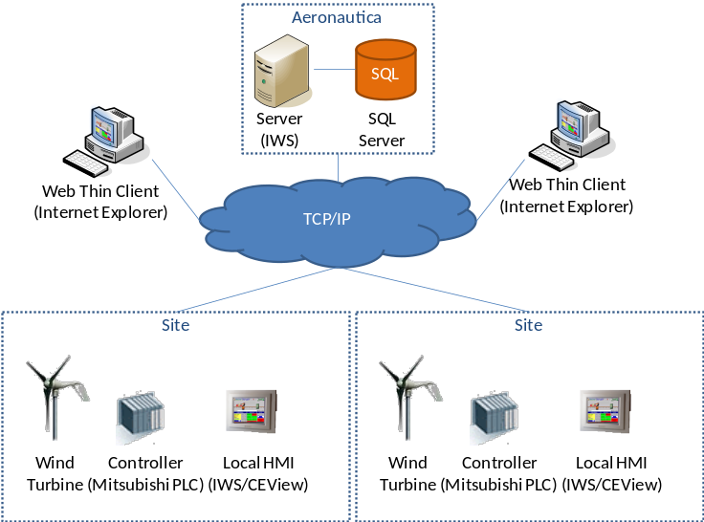
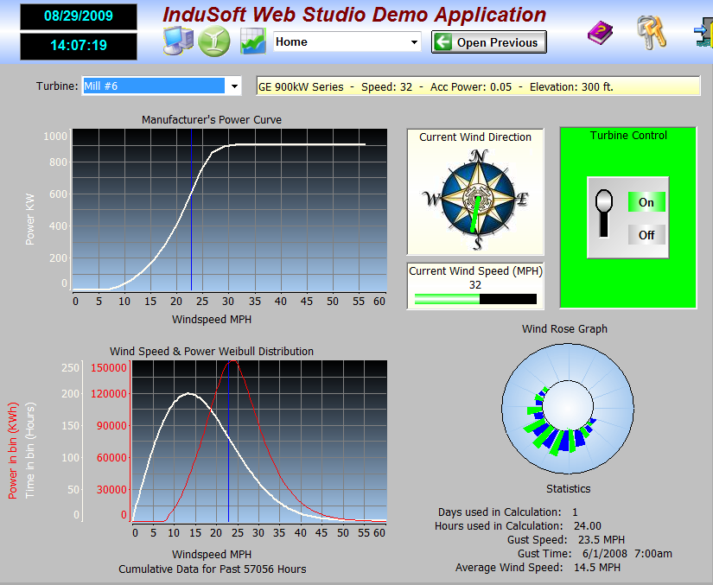
Renewable Energy - Wind
Case Study: manufacturing and marketing company that builds mid-scale
commercial and industrial wind turbines
The SCADA system is the nerve
center to the wind farms. It
connects the individual turbines,
the substation and meteorological
stations into one cohesive system
The ability to connect a number of active wind farms to their corporate headquarters or operations centers offers further opportunities for increased efficiency, cost savings and better overall management of assets.

Slide 16
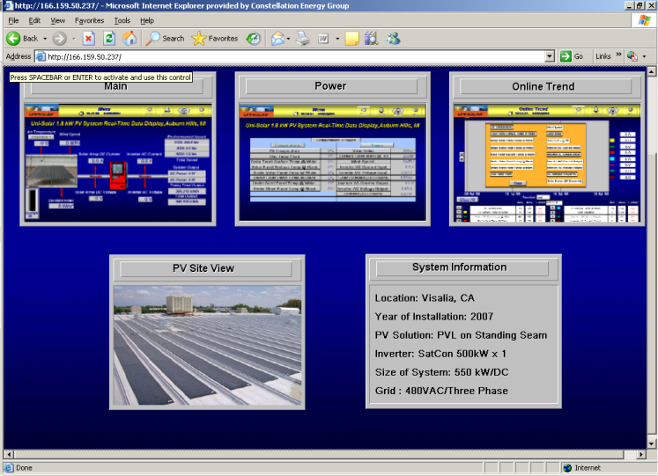
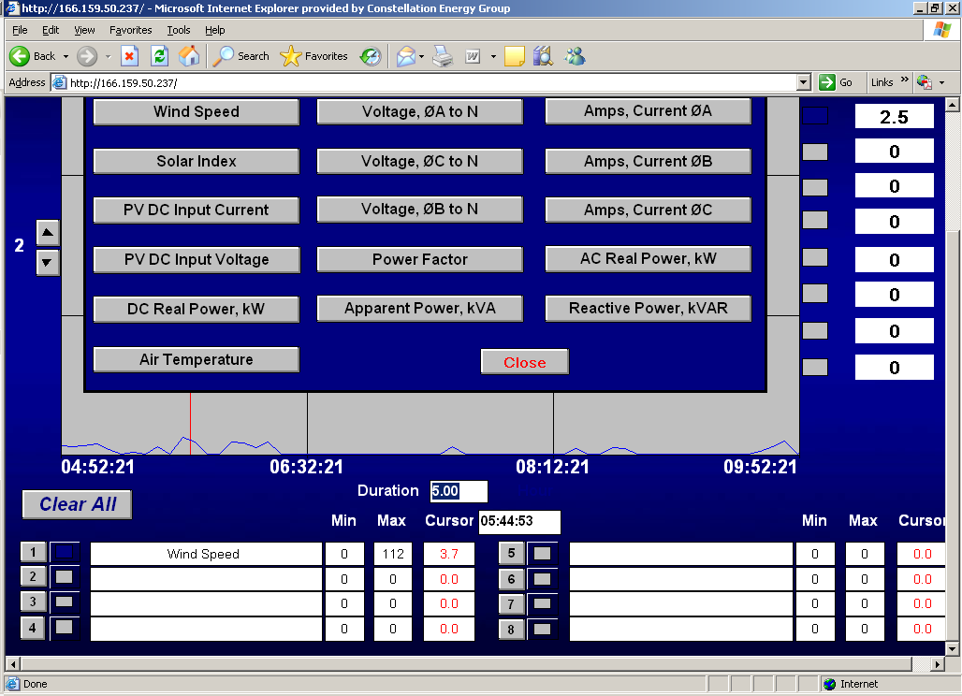
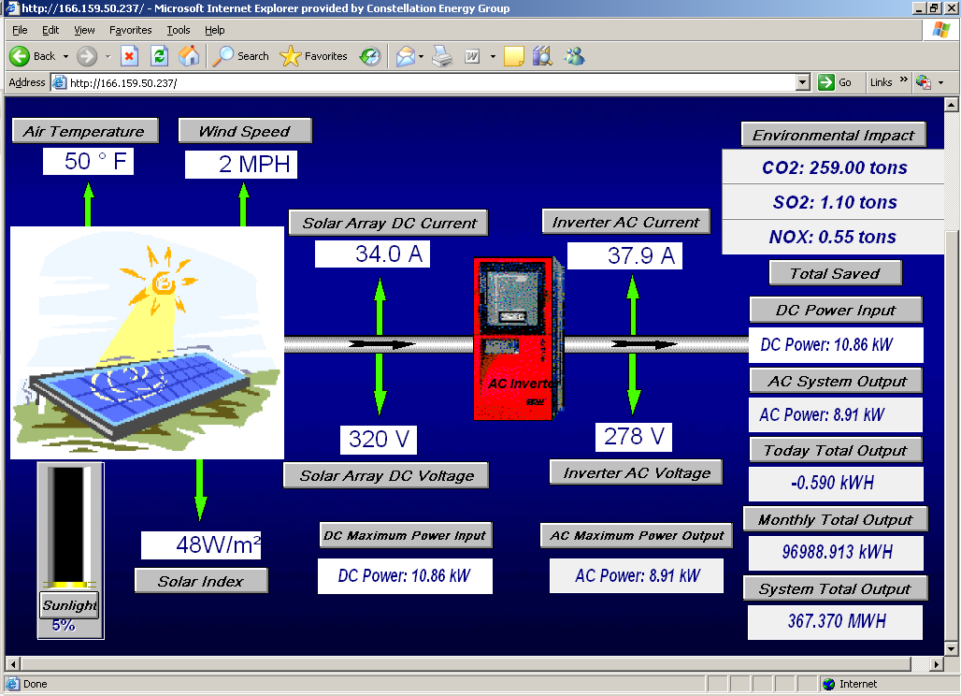
Renewable Energy - Solar
Case Study: A supplier of energy products and services to wholesale
and retail electric and natural gas customers.
The benefit is an
Integrated information on
A real time basis.
This ultimately leads to
improvement in system
safety, efficiency,
and customer service.

Slide 17
Renewable Energy – Hydro Power
Case Study: hydroelectric power company Chesf (Companhia Hidroeletrica
do Sao Francisco).
Web Thin Client
(Browser)
WAN (Internet)
GPS System
Internet
(ISP)
Synchronism Network
Development
Station
Operation
Station
Web Thin Client
(Browser)
ODBC
Interface
Control Process Network
Oracle Database
LAN (Intranet)
It is said that what
can be measured can
be managed.
PLC
PLC
PLC
PLC
IEC811-5-101 Master Station
(Corporative Network)
Hydro generator
#1
Hydro generator
#2
Hydro generator
#3
Hydro generator
#4
They required real time monitoring & remote control of hydropower plants; remote access for operation & maintenance real-

Slide 18
Renewable Energy – Hydro Power
Case Study: Companhia Energetica de Sao Paulo (CESP) - one of Brazil's largest power generators.
Benefits:
Proactive problem detection and resolution – higher reliability.
Real time strategic decision making – cost reductions and increased revenue

Slide 19
SCADA & Oil and Gas
“The worldwide market for supervisory control and data acquisition (SCADA) systems for the oil and gas industry is expected to grow at a compounded annual growth rate (CAGR) of 9.3 percent over the next five years. The market was nearly $850 million in 2007 and is forecasted to be more than $1.3 billion in 2012”
– ARC Advisory Group Inc. – 11/2008
Market Drivers:
“Worldwide SCADA market for the
oil and gas industry is expanding as
upstream development and new
production occurs in remote and
newly developed regions, and
the existing oil and gas infrastructure
makes use of the enhanced
functionalities of SCADA to improve
its core business processes of
managing global disparate assets.”
“Global demand for energy in the form
of oil and gas is driving both exploration
and production activities.”
– ARC Advisory Group Inc.
“SCADA will be at the core of technology adoptions as the world economy strengthens, and as the industry moves to improve business processes to meet growing energy demand and economic challenges. In both the upstream and midstream portions of the oil and gas industry, SCADA will play an increasingly important role in the real-time dissemination of knowledge and management control of assets.”
– ARC Advisory Group Inc.

Slide 20
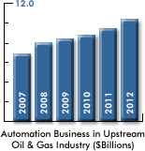
Oil & Gas Industries
“Automation expenditures by the upstream oil and gas sector, which includes exploration, production, and pipelines, are expected to grow at a compounded annual growth rate (CAGR) of nine percent over the next five years. The market was $6.9 billion in 2007 and is forecasted to grow to $10.4 billion by 2012.”
ARC Advisory Group
“With the global economic downturn as a backdrop, it would be understandable if oil companies were to dial back their capital investments as a response to reduced demand and falling oil prices. However, many of the major oil companies are maintaining their capital spending plans into 2009 and beyond.”
Allen Avery, ARC Analyst
Notes:
The economic downturn has had a pronounced impact on demand and the price of oil. Despite this, massive investments are still needed to ensure the industry has enough production capacity to meet future demand. Automation expenditures by the upstream oil and gas sector, which includes exploration, production, and pipelines, are expected to grow at a compounded annual growth rate (CAGR) of nine percent over the next five years. The market was $6.9 billion in 2007 and is forecasted to grow to $10.4 billion by 2012, according to a new ARC Advisory Group study.
The current economic climate offers many challenges, including plummeting demand, a collapse in once lofty oil prices, and a very uncertain outlook. Though oil and gas companies have made some adjustments in response to the downturn, they still plan to make major investments in coming years to build capacity for an inevitable increase in demand over the long term. “With the global economic downturn as a backdrop, it would be understandable if oil companies were to dial back their capital investments as a response to reduced demand and falling oil prices. However, many of the major oil companies are maintaining their capital spending plans into 2009 and beyond,” according to Analyst Allen Avery, the principal author of ARC’s “Automation Expenditures for Upstream Oil & Gas Industry Worldwide Outlook”.
Despite Downturn, Demand Will Grow over Long Term
Increase in demand over the long term will continue to drive significant growth in capital investments and automation expenditures in the global oil & gas industry. With access to only a minority percentage of proven reserves, integrated oil companies must attempt to replace their reserves in remote areas that are much less hospitable and more dangerous — both environmentally and politically. This is driving huge expenditures in large, complex, and difficult capital projects in the production segment.
According to estimates, demand for petroleum products will increase substantially as the economies in developing regions improve and per capita energy consumption increases. Today’s production and processing capacities struggle to keep ahead of the demand curve and both upstream and midstream facilities will need to be expanded. New sources, such as tar sands, shale oil, and coal-to-liquid gas, will require new midstream and production facilities to be developed, increasing demand for automation systems and field devices.
Asia and Latin America to Lead Growth
Regionally, the highest growth rates will occur in Asia and Latin America. Asia’s share of sales will reach 25 percent, and while expenditures in Latin America will nearly double over the forecast period, the region will still remain a relatively small portion of the overall market. Despite the strong growth in developing regions, the Middle East, home to the world’s largest conventional oil and gas deposits, will grow at average rates. North America’s upstream business, because it relies on non-conventional projects such as the Canadian Tar Sands, will trail the market.

